Slide 1
Organizational Behavior 15th Ed
Chapter 7
Robbins and Judge
Motivational Concepts

Slide 2
Chapter 7 Learning Objectives
After studying this chapter you should be able to:
Describe the three key elements of motivation.
Identify early theories of motivation and evaluate their applicability today.
Apply the predictions of self-determination theory to intrinsic and extrinsic rewards.
Understand the implications of employee engagement for management.
Compare and contrast goal setting theory and management by objectives.
Contrast reinforcement theory and goal-setting theory.
Demonstrate how organizational justice is a refinement of equity theory.
Apply the key tenets of expectancy theory to motivating employees.
Compare contemporary theories of motivation.

Slide 3
Describe the three key elements of motivation
LO 1
Many people incorrectly view motivation as a personal trait.
Motivation is “the processes that account for an individual’s intensity, direction, and persistence of effort toward attaining a goal.”

Slide 4
Describe the three key elements of motivation
LO 1
The three key elements of our definition are intensity, direction, and persistence:
Intensity is concerned with how hard a person tries.
Direction is the orientation that benefits the organization.
Persistence is a measure of how long a person can maintain his/her effort.

Slide 5
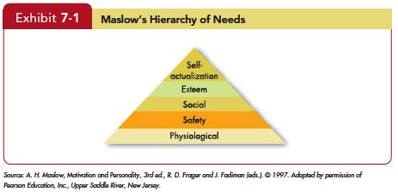
Identify early theories of motivation and evaluate their applicability today
LO 2
Notes:
.

Slide 6
Identify early theories of motivation and evaluate their applicability today
LO 2
Maslow’s need theory has received wide recognition, particularly among practicing managers.
Research does not generally validate the theory.
Some researchers have attempted to revive components of the need hierarchy concept, using principles from evolutionary psychology.
Notes:
Maslow’s need theory has received wide recognition, particularly among practicing managers. Research does not generally validate the theory. Maslow provided no empirical substantiation, and several studies that sought to validate the theory found no support for it. Some researchers have attempted to revive components of the need hierarchy concept, using principles from evolutionary psychology. Time will tell whether these revisions to Maslow’s hierarchy will be useful to practicing managers.

Slide 7
Identify early theories of motivation and evaluate their applicability today
LO 2
Theory X assumptions are basically negative.
Employees inherently dislike work and, whenever possible, will attempt to avoid it.
They must be coerced, controlled, or threatened with punishment.
Theory Y assumptions are basically positive.
Employees can view work as being as natural as rest or play.

Slide 8
Identify early theories of motivation and evaluate their applicability today
LO 2
The implications for managers are best explained by using Maslow’s framework:
Theory X: lower-order needs dominate individuals.
Theory Y: higher-order needs dominate individuals.
McGregor himself believed that Theory Y assumptions were more valid than Theory X.
No evidence to confirm that either of is valid.

Slide 9
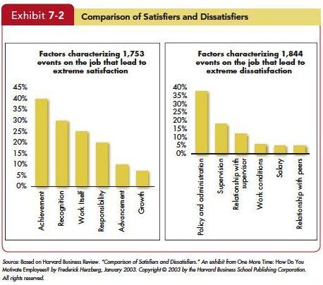
Identify early theories of motivation and evaluate their applicability today
LO 2

Slide 10
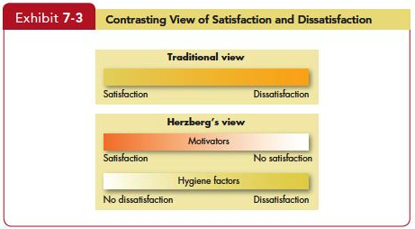
Identify early theories of motivation and evaluate their applicability today
LO 2

Slide 11
Identify early theories of motivation and evaluate their applicability today
LO 2
Criticisms of Herzberg’s theory:
It relies on self-reports .
The reliability of methodology is questioned.
No overall measure of satisfaction was utilized.
Herzberg assumed a relationship between satisfaction and productivity, but the research methodology he used looked only at satisfaction, not at productivity.

Slide 12
Identify early theories of motivation and evaluate their applicability today
LO 2
McClelland’s Theory of Needs
The theory focuses on three needs: achievement, power, and affiliation.
Need for achievement (nAch)
The drive to excel, to achieve in relation to a set of standards, to strive to succeed.

Slide 13
Identify early theories of motivation and evaluate their applicability today
LO 2
Need for achievement predicted relationships
With a high degree of personal responsibility and feedback and an intermediate degree of risk, high achievers are strongly motivated.
A high need to achieve does not necessarily make someone a good manager, especially in large organizations.
Needs for affiliation and power tend to be closely related to managerial success.

Slide 14
Identify early theories of motivation and evaluate their applicability today
LO 2
Need for power: The need to make others behave in a way that they would not have behaved otherwise.
Individuals high in nPow enjoy being “in charge.”
Strive for influence over others.
Prefer to be placed into competitive and status-oriented situations.

Slide 15
Identify early theories of motivation and evaluate their applicability today
LO 2
McClelland’s theory has had the best support.
It has less practical effect than the others.
Because McClelland argued that the three needs are subconscious—we may rank high on them but not know it—measuring them is not easy.
The process is time consuming and expensive, and few organizations have been willing to invest in measuring McClelland’s concept.

Slide 16
Apply the predictions of self-determination theory to intrinsic and extrinsic rewards
LO 3
Proposes that people prefer to feel they have control over their actions.
Research on self-determination theory has focused on cognitive evaluation theory.
People paid for work feel less like they want to do it and more like they have to it.
Proposes that in addition to being driven by a need for autonomy, people seek ways to achieve competence and positive connections to others.

Slide 17
Apply the predictions of self-determination theory to intrinsic and extrinsic rewards
LO 3
Extrinsic rewards used as payoffs for performance, employees feel they are doing a good job.
Eliminating extrinsic rewards can also shift an individual’s perception of why she works on a task from an external to an internal explanation.
Self-determination theory acknowledges that extrinsic rewards can improve even intrinsic motivation under specific circumstances.

Slide 18
Apply the predictions of self-determination theory to intrinsic and extrinsic rewards
LO 3
Self-determination theory suggestions for providing rewards.
A senior sales representative may be motivated by a commission.
A computer programmer who values writing code because she likes to solve problems might react negatively to having to write a certain number of lines of code every day.

Slide 19
Apply the predictions of self-determination theory to intrinsic and extrinsic rewards
LO 3
A recent outgrowth of self-determination theory is self-concordance, which considers how strongly peoples’ reasons for pursuing goals are consistent with their interests and core values.

Slide 20
Apply the predictions of self-determination theory to intrinsic and extrinsic rewards
LO 3
Implications
For individuals, it means choose your job for reasons other than extrinsic rewards.
For organizations, it means managers should provide intrinsic as well as extrinsic incentives.

Slide 21
Understand the implications of employee engagement for management
LO 4
Job engagement, the investment of an employee’s physical, cognitive, and emotional energies into job performance.
Many studies attempt to measure this deeper level of commitment.
Academic studies have found that job engagement is positively associated with performance and citizenship behaviors.

Slide 22
Understand the implications of employee engagement for management
LO 4
Ways to increase job engagement:
Degree to which an employee believes it is meaningful to engage in work.
Another factor is a match between the individual’s values and the organization’s.
Leadership behaviors that inspire workers to a greater sense of mission.

Slide 23
Understand the implications of employee engagement for management
LO 4
Construct is partially redundant with job attitudes.
May also predict work outcomes better than job attitudes.
May be a “dark side”, as evidenced by positive relationships between engagement and work-family conflict.

Slide 24
Compare and contrast goal setting theory and management by objectives
LO 5
Goal-Setting Theory proposed by Edwin Locke.
Goals tell an employee what needs to be done and how much effort is needed.
Evidence strongly suggests
that specific goals increase performance,
that difficult goals, when accepted, result in higher performance than do easy goals; and
that feedback leads to higher performance than does nonfeedback.

Slide 25
Compare and contrast goal setting theory and management by objectives
LO 5
There are contingencies in goal-setting theory.
Feedback
Performance relationship
Goal commitment
Task characteristics
National culture

Slide 26
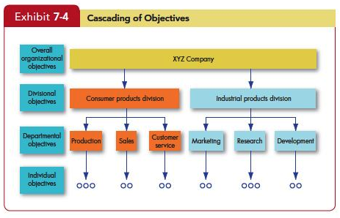
Compare and contrast goal setting theory and management by objectives
LO 5

Slide 27
Self-Efficacy Theory
LO 5
Self-Efficacy Theory
Enactive mastery
Vicarious modeling
Verbal persuasion
Arousal
Known also as social cognitive theory and social learning theory

Slide 28
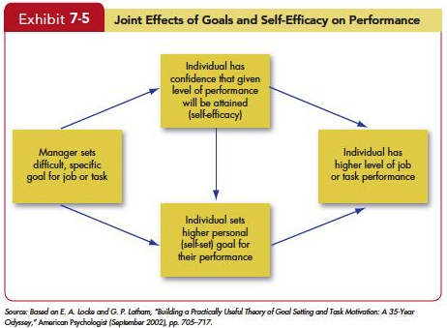
Self-Efficacy Theory
LO 5

Slide 29
Self-Efficacy Theory
LO 5
Implications of Efficacy Theory
Training programs often make use of enactive mastery by having people practice and build their skills.
The best way for a manager to use verbal persuasion is through the Pygmalion effect or the Galatea effect.
Intelligence and personality are absent from Bandura’s list, but they can increase self-efficacy.

Slide 30
Contrast reinforcement theory and goal-setting theory
LO 6
Goal-Setting vs. Reinforcement Theory
Goal-setting is a cognitive approach, proposing that an individual’s purposes direct his action.
Reinforcement theory, in contrast, takes a behavioristic view, arguing that reinforcement conditions behavior.
The two theories are clearly at odds philosophically. Reinforcement theorists see behavior as environmentally caused.

Slide 31
Contrast reinforcement theory and goal-setting theory
LO 6
Reinforcement theory ignores the inner state of the individual and concentrates solely on what happens when he or she takes some action.
Operant conditioning theory argues that people learn to behave to get something they want or to avoid something they don’t want.

Slide 32
Contrast reinforcement theory and goal-setting theory
LO 6
In its pure form, reinforcement theory ignores feelings, attitudes, expectations, and other cognitive variables known to affect behavior.
Some researchers look at the same experiments reinforcement theorists use to support their position and interpret the findings in a framework.
Reinforcement is undoubtedly an important influence on behavior, but few scholars are prepared to argue it is the only one.

Slide 33
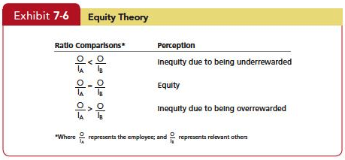
Demonstrate how organizational justice is a refinement of equity theory
LO 7

Slide 34
Demonstrate how organizational justice is a refinement of equity theory
LO 7
Which referent an employee chooses will be influenced by the information the employee holds about referents, as well as by the attractiveness of the referent.
Gender
Length of tenure
Level in the organization
Professional ranks and higher education

Slide 35
Demonstrate how organizational justice is a refinement of equity theory
LO 7
When employees perceive an inequity, they can be predicted to make one of six choices:
Change their inputs.
Change their outcomes.
Distort perceptions of self.
Distort perceptions of others.
Choose a different referent.
Leave the field.

Slide 36
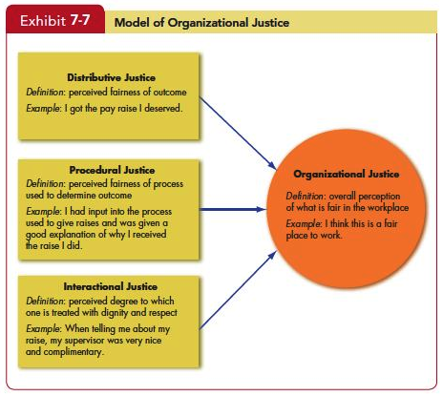
Demonstrate how organizational justice is a refinement of equity theory
LO 7

Slide 37
Apply the key tenets of expectancy theory to motivating employees
LO 8
Expectancy theory argues that a tendency to act in a certain way depends on an expectation that the act will be followed by a given outcome and the attractiveness of that outcome to the individual.
An employee will be motivated to exert a high level of effort when he/she believes that:
Effort will lead to a good performance appraisal.
A good appraisal will lead to rewards.
The rewards will satisfy his/her personal goals.

Slide 38
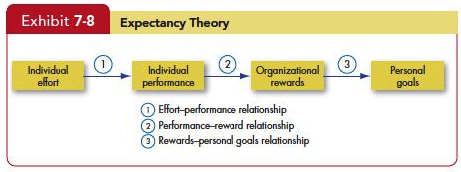
Apply the key tenets of expectancy theory to motivating employees
LO 8

Slide 39
Apply the key tenets of expectancy theory to motivating employees
LO 8
The key to expectancy theory is the understanding of an individual’s goals and the linkage between effort and performance, between performance and rewards, and finally, between the rewards and individual goal satisfaction.
Some critics suggest that the theory has only limited use, arguing that it tends to be more valid for predicting in situations where effort-performance and performance-reward linkages are clearly perceived by the individual.

Slide 40
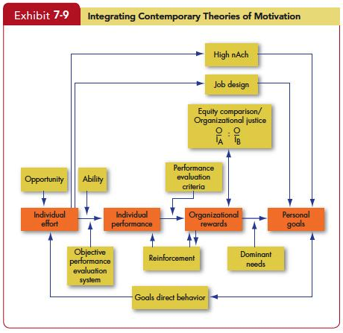
Compare contemporary theories of motivation
LO 9
Notes:
The Model in Exhibit 7–9 integrates much of what we know about motivation. Its basic foundation is the expectancy model. Expectancy theory predicts that an employee will exert a high level of effort if he/she perceives that there is a strong relationship between effort and performance, performance and rewards, and rewards and satisfaction of personal goals. Each of these relationships, in turn, is influenced by certain factors. For effort to lead to good performance, the individual must have the requisite ability to perform, and the performance appraisal system must be perceived as being fair and objective. The final link in expectancy theory is the rewards-goals relationship. The model considers the achievement, need, reinforcement, and equity/organizational justice theories. High achievers are internally driven as long as the jobs they are doing provide them with personal responsibility, feedback, and moderate risks. Reinforcement theory recognizes that the organization’s rewards reinforce the individual’s performance. Individuals will compare the rewards (outcomes) they receive from the inputs they make with the outcome-input ratio of relevant others and inequities may influence the effort expended.

Slide 41
Summary
The motivation theories in this chapter differ in their predictive strength.
Need Theories
Self-Determination Theory and Cognitive Evaluation Theory
Goal-Setting Theory
Reinforcement Theory
Equity Theory/Organizational Justice
Expectancy Theory

Slide 42

All rights reserved. No part of this publication may be reproduced, stored in a retrieval system, or transmitted, in any form or by any means, electronic, mechanical, photocopying, recording, or otherwise, without the prior written permission of the publisher. Printed in the United States of America.
Copyright © 2013 Pearson Education, Inc. publishing as Prentice Hall
Notes:
All rights reserved. No part of this publication may be reproduced, stored in a retrieval system, or transmitted, in any form or by any means, electronic, mechanical, photocopying, recording, or otherwise, without the prior written permission of the publisher. Printed in the United States of America.

